Slide 1
Invited Talk
Telepresence in the Real World
--- ACM Multimedia 2004 Conference Workshop on Effective Telepresence (ETP’04)
Duffie White
Presented by: Weihong Li

Slide 2
Background
Computer Graphics provide only visual displays
  Movies
  Virtual Reality
Augmented Reality in Specialized Field
  Medical Applications
General-purpose 3D Eye Contact Communication

Slide 3
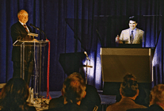
3D Eye Contact Teleconference
What does it look like?
Teleportec Company

Slide 4
Typical Requirements
High Bandwidth Network Communication
  T1 (1.5Mbps) / ISDN (384Kbps)
  Internet 2
Multimedia: Video and Audio standard
Computer Vision Techniques
  Camera Calibration
  Stereo Telepresence
  Object Tracking

Slide 5
Typical System Design

Slide 6
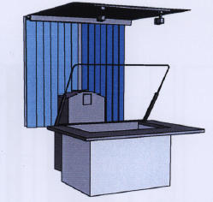
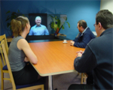
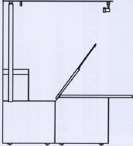
Real Products (1)
Conference Table

Slide 7
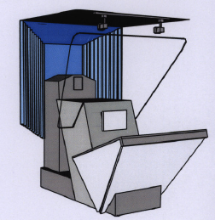
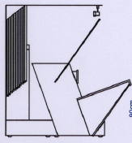
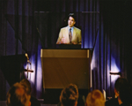
Real Products (2)
Lectern

Slide 8
Applications
Distance Education
Training
Health Care
Government
Financial Services
3D Conference
Corporate Communication

Slide 9
Current Problems
Not Convenient to Use
  Heavy
  Complicated
Expensive
  Usually $20,000 or above
  High Overhead

Slide 10
Conclusion
3D Eye Contact Telepresence
Problems

